Slide 1
Nonparametric Scene Parsing

Slide 2
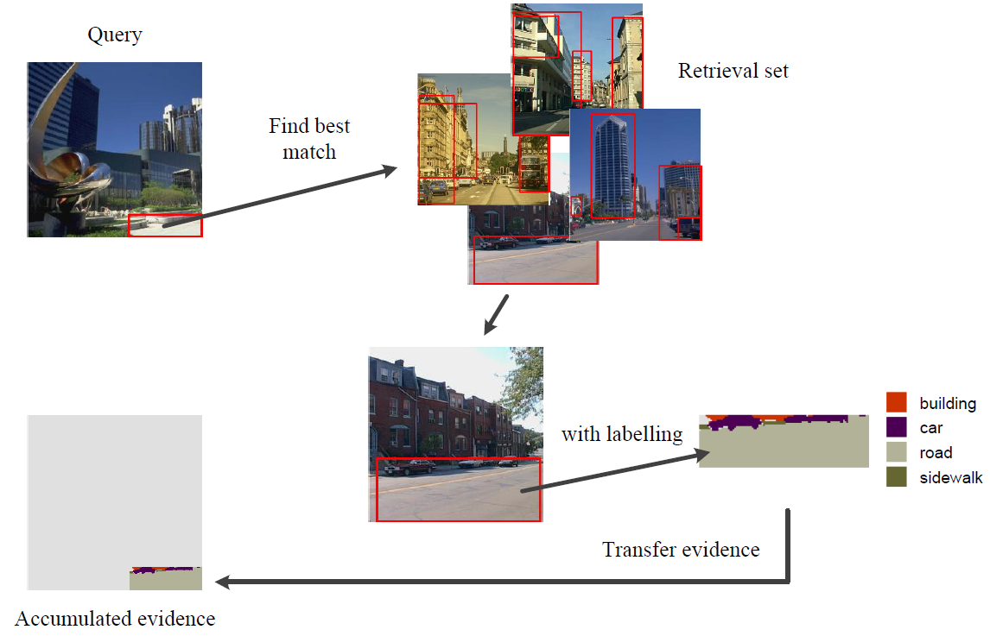
Windows based label transfer [TJ14]
F. Tung and J. J. Little. “CollageParsing: Nonparametric scene parsing by adaptive overlapping windows.” In ECCV, 2014.

Slide 3
Baseline System
Nonparametric scene parsing
Image retrieval
Image segmentation
Object window (instead of superpixels)
Label transfer
Window based label transfer
Align label to superpixel

Slide 4
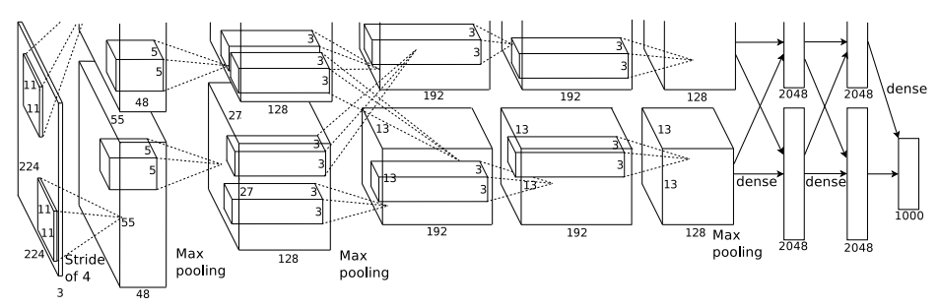
Image Retrieval
Retrieve similar image
Caffe CNN feature (7th layer) [KSH12]
Euclidean distance
Retrieve 400 images
7
A. Krizhevsky, I. Sutskever, and G. E. Hinton. ImageNet classification with deep convolutional neural networks. In NIPS, 2012.

Slide 5
Image Segmentation
R-CNN [GDDM14]
Region proposals / feature extraction
Selective search [USGS12]
Dilate 16 pixels
Resize to 227*227
Extract Caffe CNN feature
Ross Girshick, Jeff Donahue, Trevor Darrell and Jitendra Malik, “Rich feature hierarchies for accurate object detection and semantic segmentation,” CVPR, 2014.
J.R.R. Uijlings, K.E.A. Van de Sande, T.Gevers, and A.W.M. Smeulders, “Selective Search for Object Recognition,” IJCV, 2012

Slide 6

Label Transfer
Label Transfer
Four-connected pairwise MRF model
Alpha-beta swap algorithm [BVZ01]
Energy Function:
Adjacent pixels: p, q
Class : c
Unary energy
Label cost
Y. Boykov, O. Veksler, and R. Zabih. “Fast approximate energy minimization via graph cuts.” PAMI, 23(11):1222 – 1239, 2001.

Slide 7


Label Transfer
Energy function:
Unary energy
Label cost
Label co-occurrence statistics
Unary energy
Label cost
Window similarity
Give the penalty to
frequency of class

Slide 8
Align Labeling
Refine label region
To improve the alignment of the labelling
Superpixels in the query image share the same label
Assigned the most common label in the superpixels

Slide 9
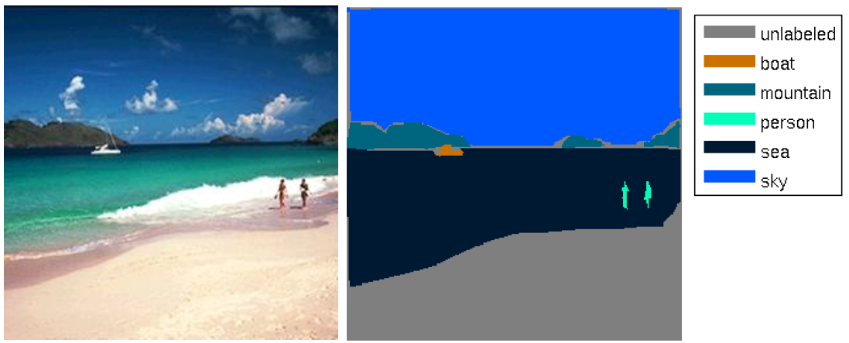

Dataset
SIFT Flow
200 testing images
2488 training images
33 classes
Image size 256$×$256

Slide 10
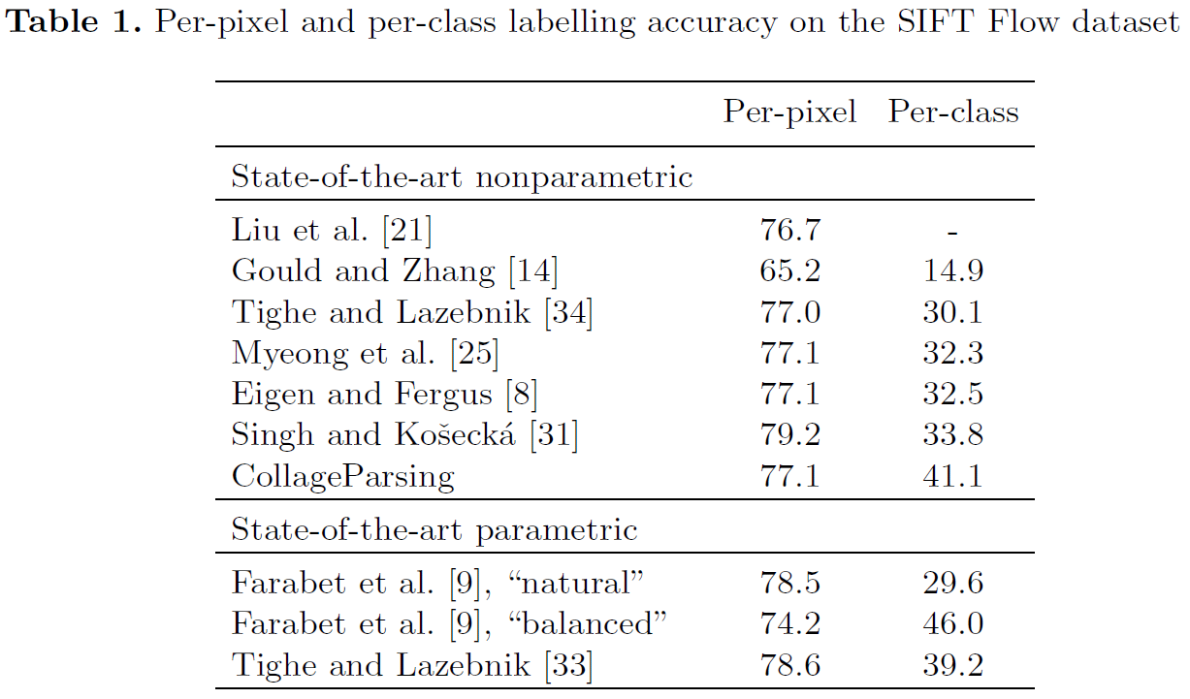
Experiments
[TL14] Sift Flow dataset
[TL14]
[YPCY14] (non-para) 79.8 48.7
J. Yang, B. Price, S. Cohen and M.Yang. Context driven scene parsing with attention to rare classes. In CVPR, 2014.
F. Tung and J. J. Little. CollageParsing: Nonparametric scene parsing by adaptive overlapping windows. In ECCV, 2014.
[33] J. Tighe and S. Lazebnik. Finding things: Image parsing with regions and per-exemplar detectors. In CVPR, 2013.

Slide 11
Results
 | per-pixel | per-class
State-of-the-art
baseline [YPCY14] | 78.0 | 27.5 | Superpixel based
full [YPCY14] | 79.8 | 48.7 | Rare class / semantic context
Collage Parsing [TJ14] | 77.1 | 41.1 | Window based
My results
superPixel based | 71.59 | 22.08
window based | 75.93 | 40.87 | K= 40/1
window based | 79.28 | 34.11 | K= 40/30
window based | 79.83 | 37.58 | K= 400/1 *
window based | 77.26 | 40.58 | K= 400/30
Only 1 time retrieval
J. Yang, B. Price, S. Cohen and M.Yang. “Context driven scene parsing with attention to rare classes.” In CVPR, 2014.
F. Tung and J. J. Little. “CollageParsing: Nonparametric scene parsing by adaptive overlapping windows.” In ECCV, 2014.

Slide 12
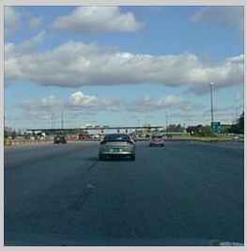
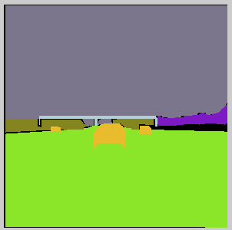
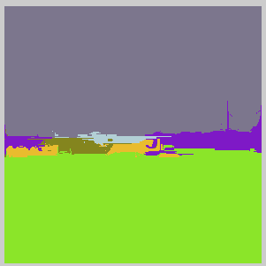
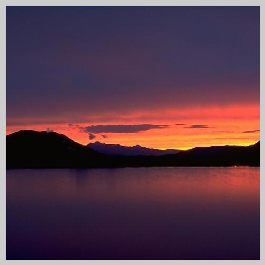
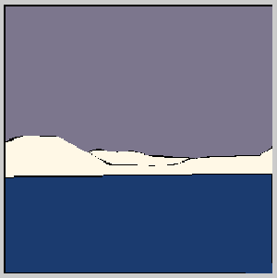

Reults

Slide 13
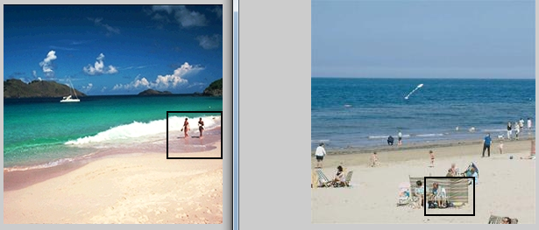
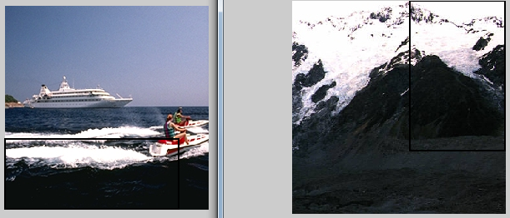
Problem
Object location/shape/size in the window
Window matching fail

Slide 14
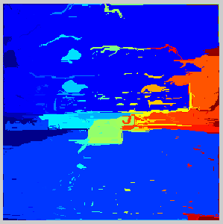
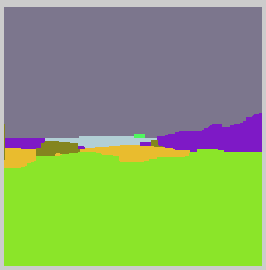

Slide 15
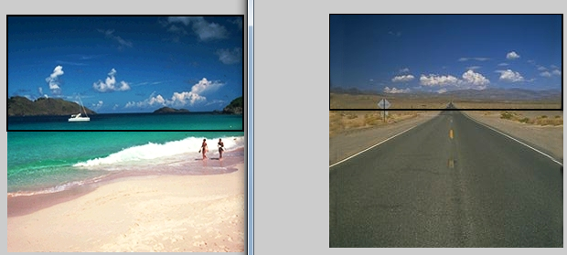
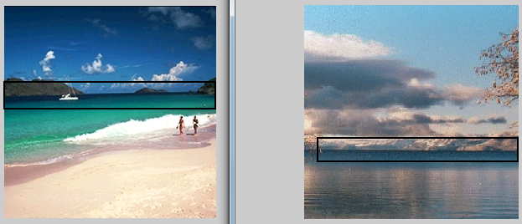

Slide 16
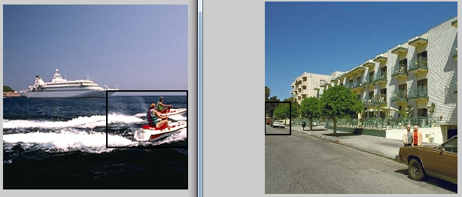

Slide 17
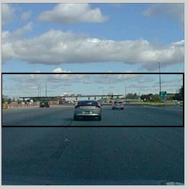
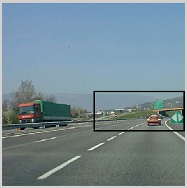
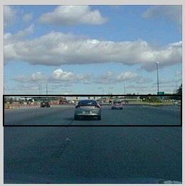
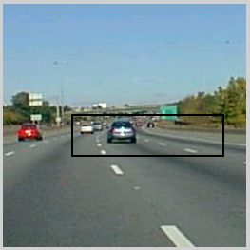

Slide 18
